Slide 1

Lecture-5
Memory Management
Core Topics:
Logical vs Physical Address Space
Contiguous Allocation, Paging, Segmentation
Virtual Memory: Demand Paging, Page Replacement Algorithms (FIFO, LRU, Optimal)

Slide 2

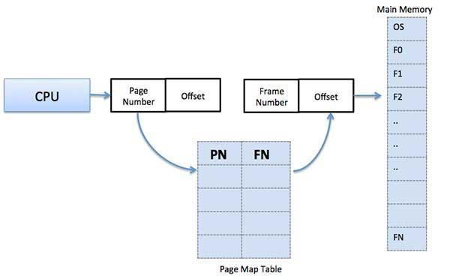
Memory Management
Memory management is the functionality of an operating system which handles or manages primary memory and moves processes back and forth between main memory and disk during execution.
Memory management keeps track of each and every memory location, regardless of either it is allocated to some process or it is free.

Slide 3
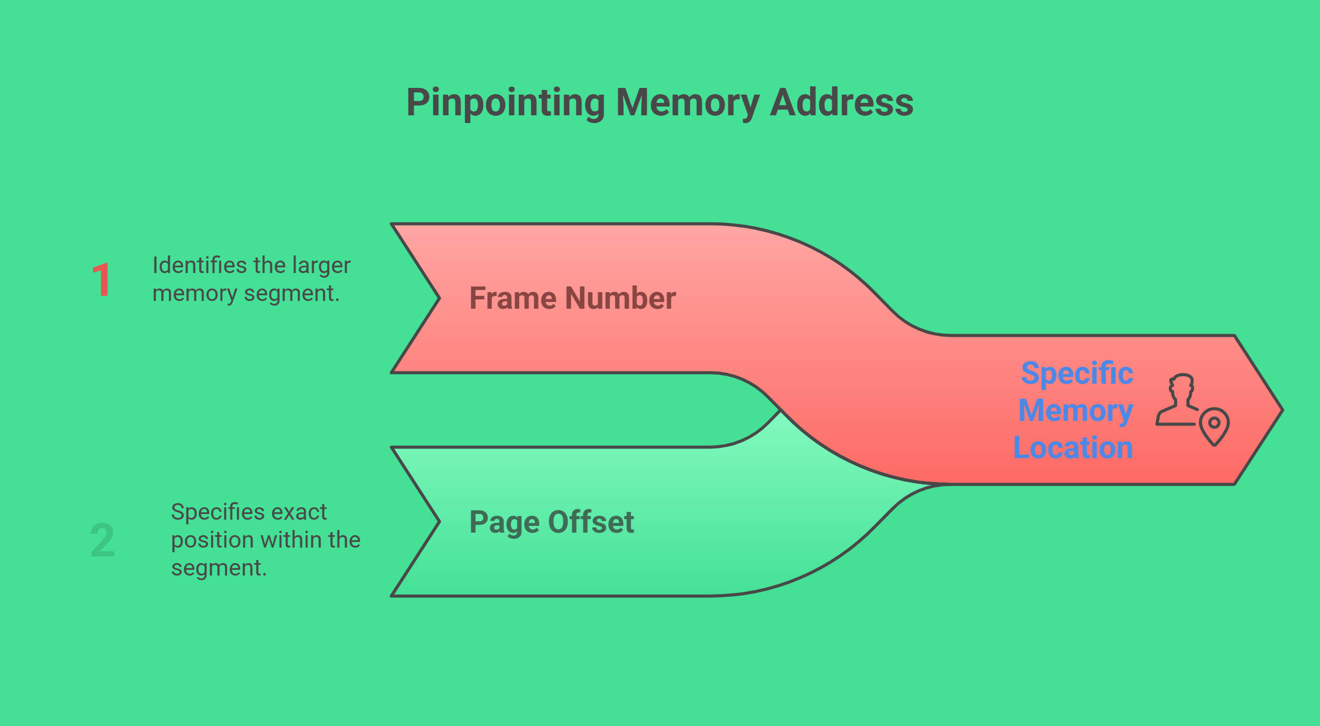
Physical Address
The actual address in the computer's main memory (RAM).
It is where data and instructions are stored physically.
The operating system or hardware translates logical addresses to physical addresses.

Slide 4
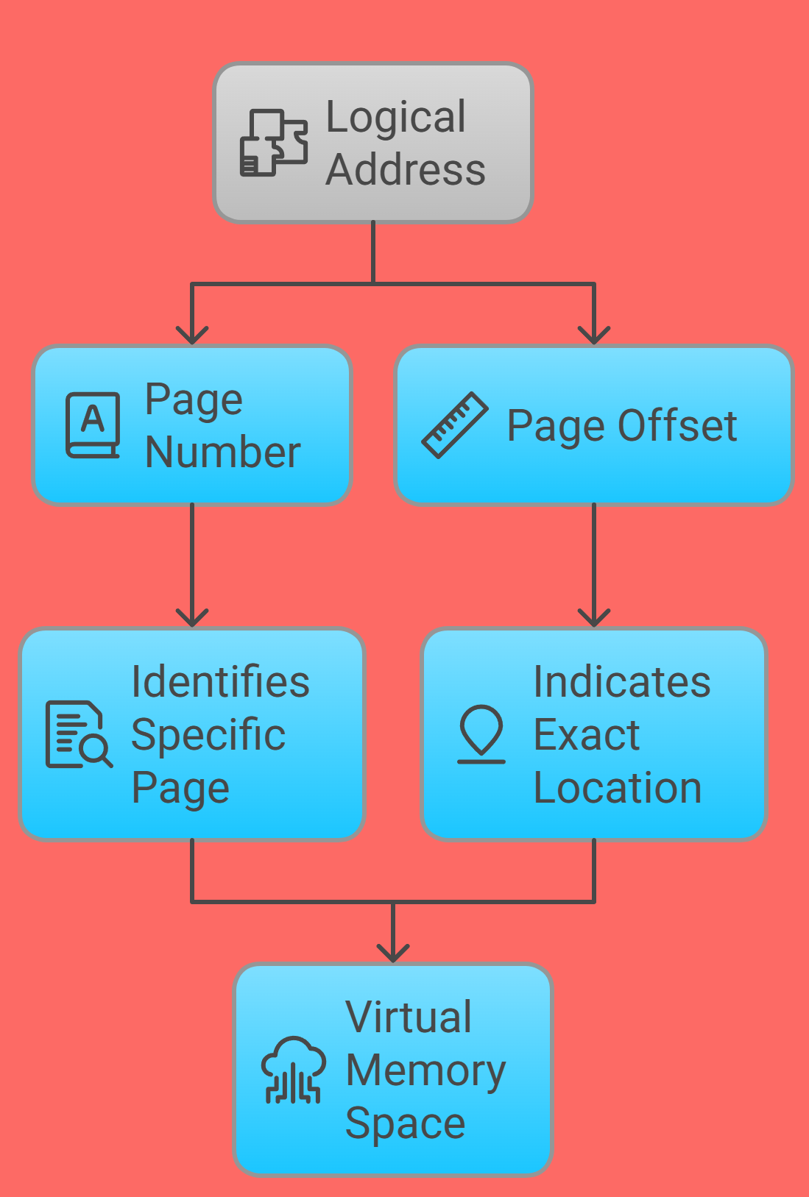
Logical Address
The address generated by the CPU during a program's execution.
It is used by a program to access memory locations.
Logical addresses are virtual and do not refer to actual physical locations in memory.
They are mapped to physical addresses by the memory management unit (MMU).

Slide 5
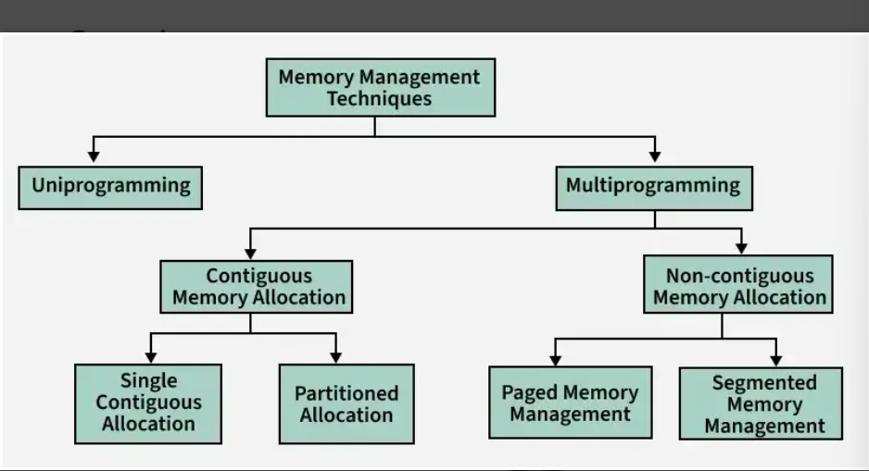
Memory Management Techniques

Slide 6
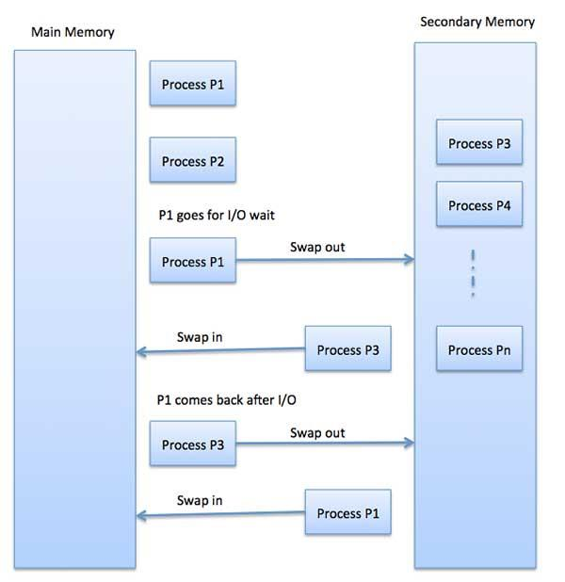
Fragmentation
As processes are loaded and removed from memory, the free memory space is broken into little pieces. It happens after sometimes that processes cannot be allocated to memory blocks considering their small size and memory blocks remains unused. This problem is known as Fragmentation.

Slide 7
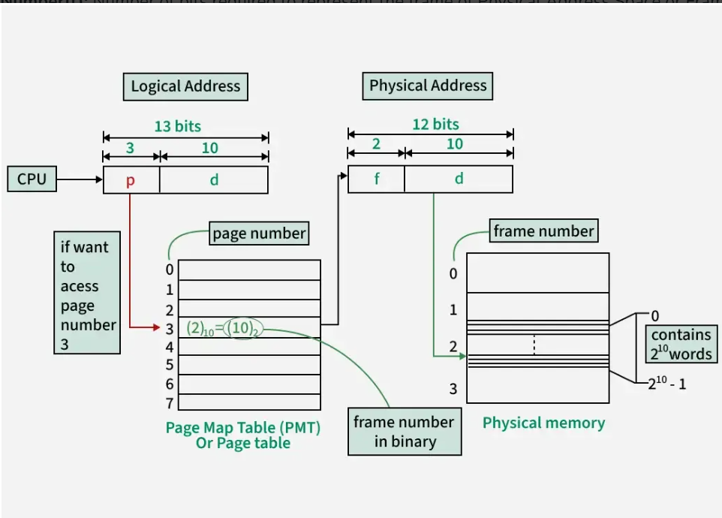
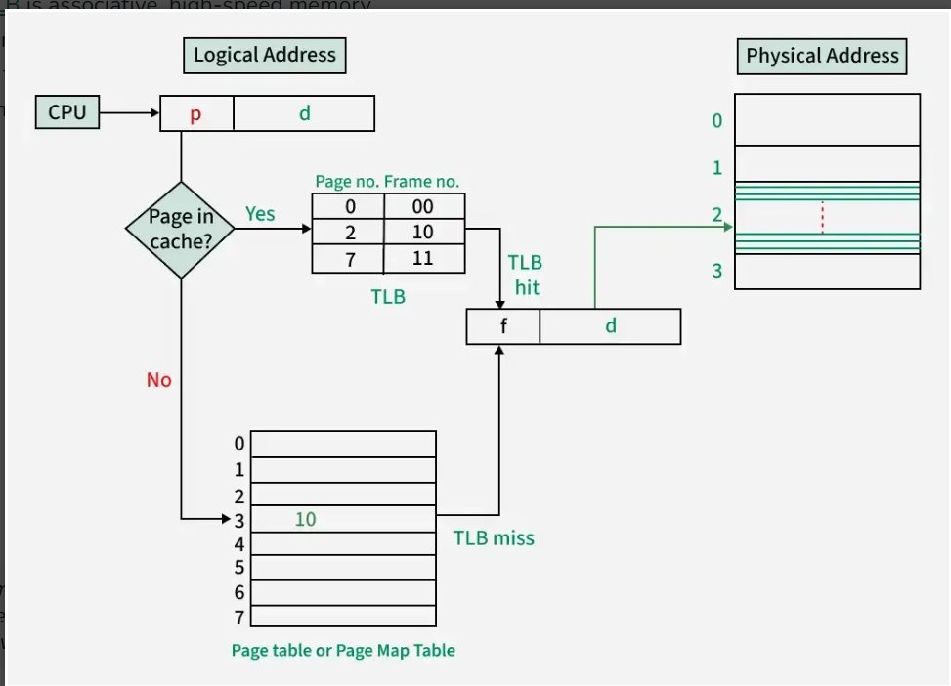
Paging
Paging is a memory management technique where logical memory is divided into fixed-size pages and physical memory into frames.
The Operating System uses a page table to map each page to a frame, enabling non-contiguous memory allocation and eliminating external fragmentation.
Address translation occurs during program execution, combining the page number and offset to generate the corresponding physical address efficiently.

Slide 8
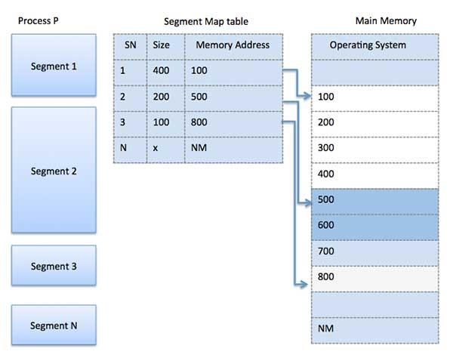
Segmentation
Segmentation divides memory into variable-sized segments like code, data, stack, each with its own base and limit.
Address translation uses a segment table; invalid offset causes a segmentation fault.
Best Fit, Worst Fit, First Fit are allocation strategies—Best Fit minimizes wasted space, Worst Fit leaves large holes, First Fit is fastest but may cause fragmentation.

Slide 9
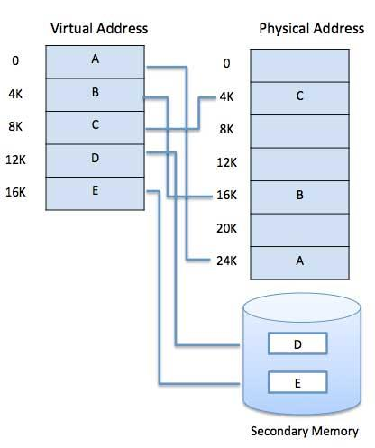
Virtual Memory
A computer can address more memory than the amount physically installed on the system. This extra memory is actually called virtual memory. When logical Address Space is more than Physical address Space, on that time Virtual Address is created. The basic intention of implementing the concepts of Virtual memory to enlarge the address spaces for programs.

Slide 10
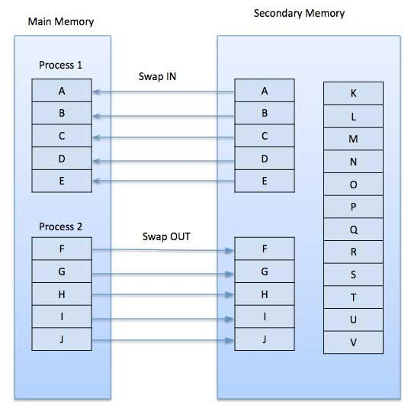
Demand Paging
A demand paging system is a paging system with swapping where processes reside in secondary memory and pages are loaded only on demand.
Belady’s Anomaly
More number of page faults occur when more frames are allocated to a process.

Slide 11
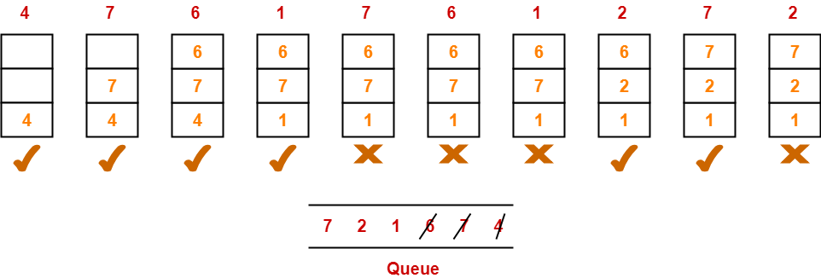
Page Replacement Algorithms- FIFO
Replace the page which is inserted First!
A system uses 3 page frames for storing process pages in main memory. It uses the First in First out (FIFO) page replacement policy. Assume that all the page frames are initially empty. What is the total number of page faults that will occur while processing the page reference string given below-
4 , 7, 6, 1, 7, 6, 1, 2, 7, 2
Total number of page faults occurred = 6

Slide 12
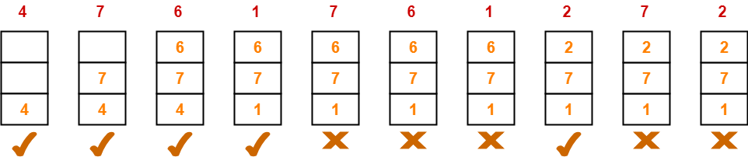
Optimal
The page replaced which is used minimum in future or the page replace whose demand is minimum in future.
A system uses 3 page frames for storing process pages in main memory. It uses the Optimal page replacement policy. Assume that all the page frames are initially empty. What is the total number of page faults that will occur while processing the page reference string given below-
4 , 7, 6, 1, 7, 6, 1, 2, 7, 2
Total number of page faults occurred = 5

Slide 13
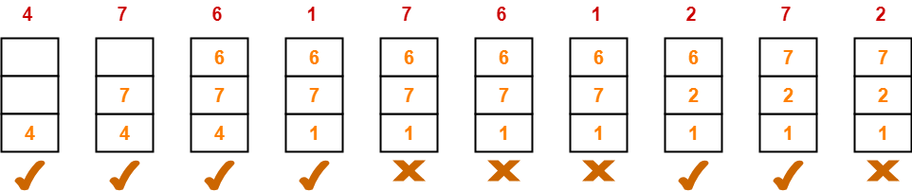
LRU- Least Recently Used
The page which was used minimum in recent past history.
A system uses 3 page frames for storing process pages in main memory. It uses the LRU page replacement policy. Assume that all the page frames are initially empty. What is the total number of page faults that will occur while processing the page reference string given below-
4 , 7, 6, 1, 7, 6, 1, 2, 7, 2
Total number of page faults occurred = 6

Slide 14
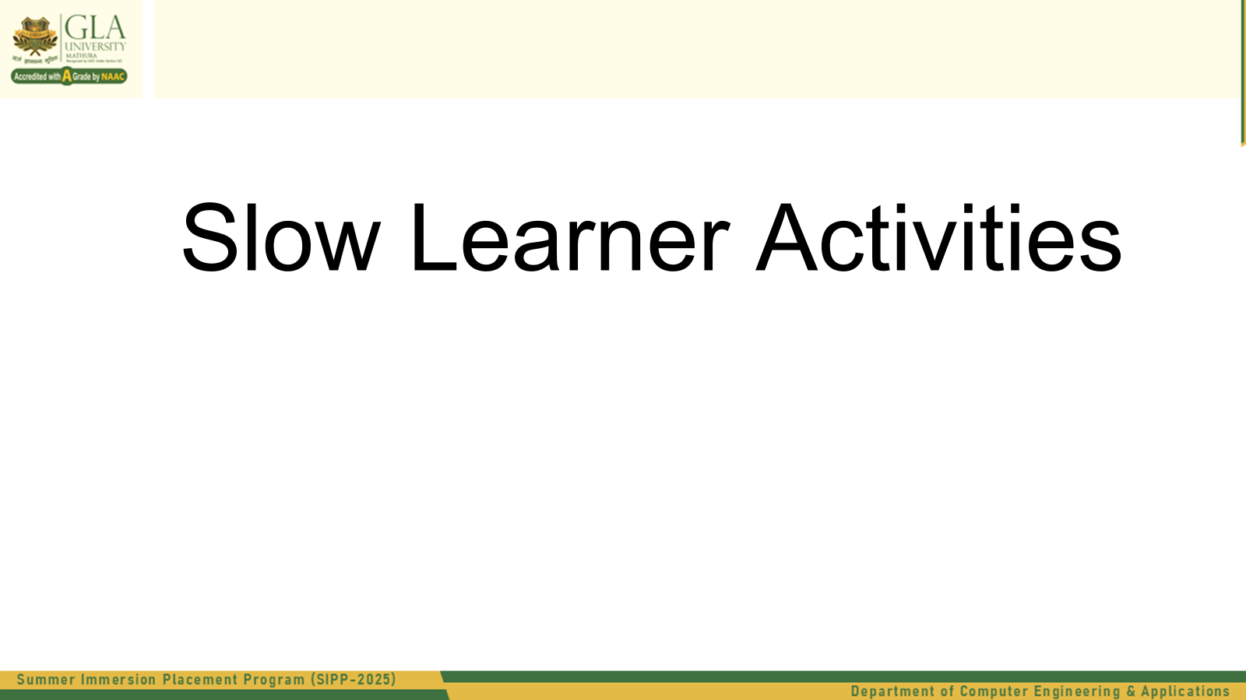

Slide 15
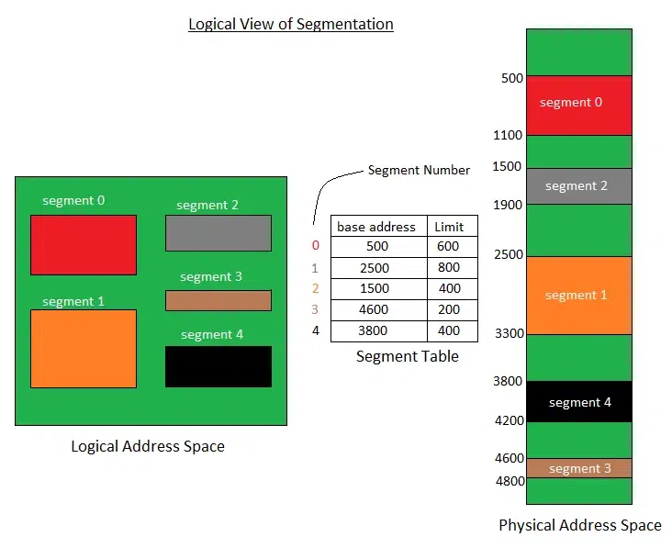

Slide 16
Practice
(A) Address Translation
Given the logical address (Segment 1, Offset 300):
What is the base address of Segment 1?
Is the offset valid? Justify your answer.
If valid, calculate the Physical Address.
(B) Labeling Practice
From the diagram:
Label the segment that starts at physical address 3800.
Label the segment that has a limit of 400 but starts at 1500.

Slide 17
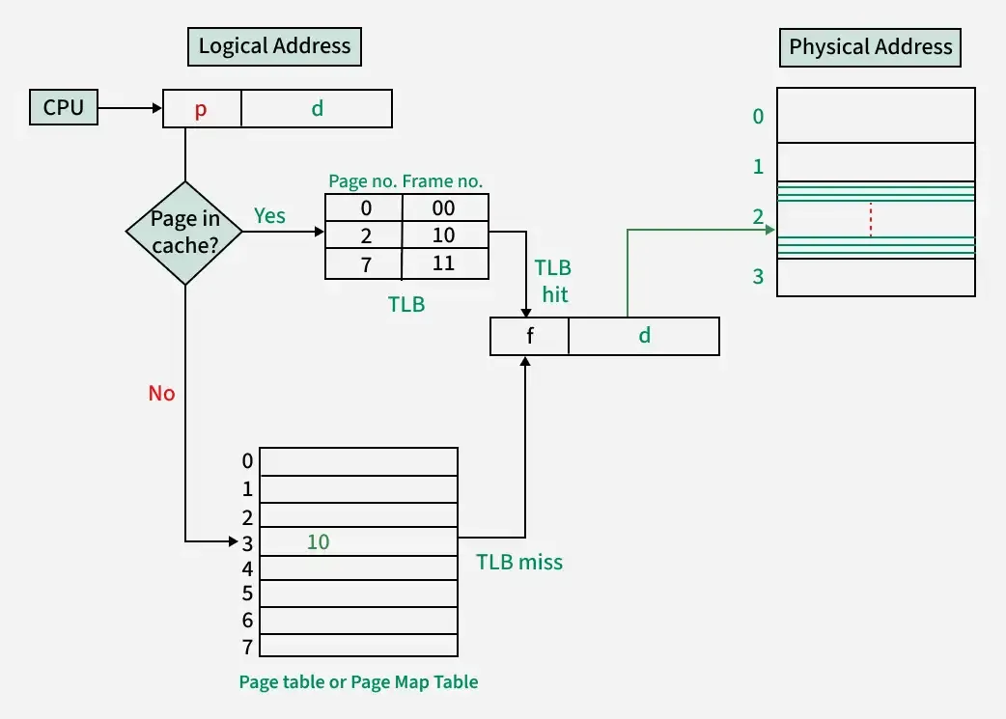
Practice Question
1.(Logical Address = (Page Number = 2, Offset = d)
Is there a TLB hit or TLB miss?
If it’s a hit, what is the corresponding frame number?
Write the final physical address (Frame number + Offset).
2.Logical Address = (Page Number = 3, Offset = d)
Will the CPU find the page in the TLB?
If not, where does it look next?
From the page table, what is the frame number for Page 3?

Slide 18
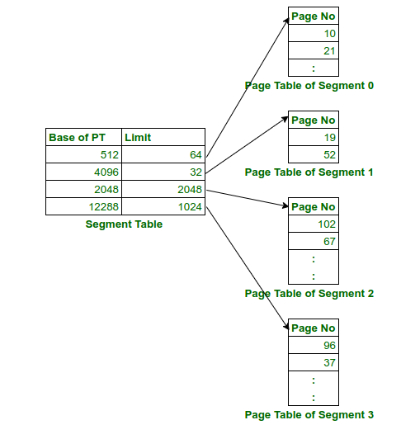
Two-Level Address Translation – Segmentation with Paging
A system uses segmentation with paging. The Segment Table contains the base addresses and limits for each segment's page table. The Page Table for each Segment maps logical page numbers to physical page frames.
Now, consider a logical address given as a triple: (Segment Number = 1, Page Number = 1, Offset = 20)
Using the information from the diagram:
→Answer the following:
(a) Is the given logical address valid? Justify your answer using the limit value. (b) If valid, calculate the physical address using the page table of Segment 1. Assume that each page has a size of 64 bytes.

Slide 19


Slide 20
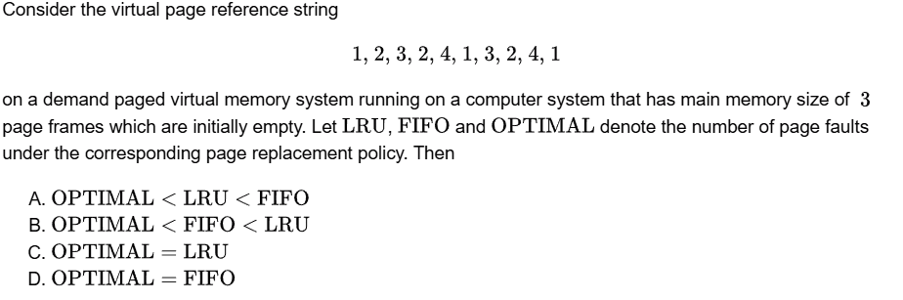

Slide 21
Effective Access Time
An operating system supports a paged virtual memory. The central processor has a cycle time of 1 microsecond. It costs an additional 1 microsecond to access a page other than the current one. Pages have 1,000 words, and the paging device is a drum that rotates at 3,000 revolutions per minute and transfers 1 million words per second. The following statistical measurements were obtained from the system:
• One percent of all instructions executed accessed a page other than the current page.
• Of the instructions that accessed another page, 80 percent accessed a page already in memory.
• When a new page was required, the replaced page was modied 50 percent of the time.
Calculate the effective instruction time on this system, assuming that the system is running one process only and that the processor is idle during drum transfers.

Slide 22
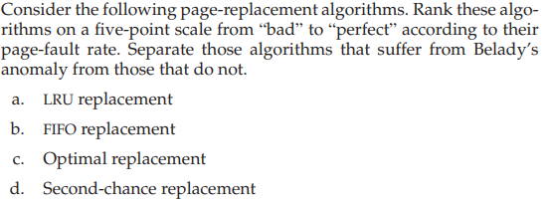
Page Replacement Algorithms

Slide 23
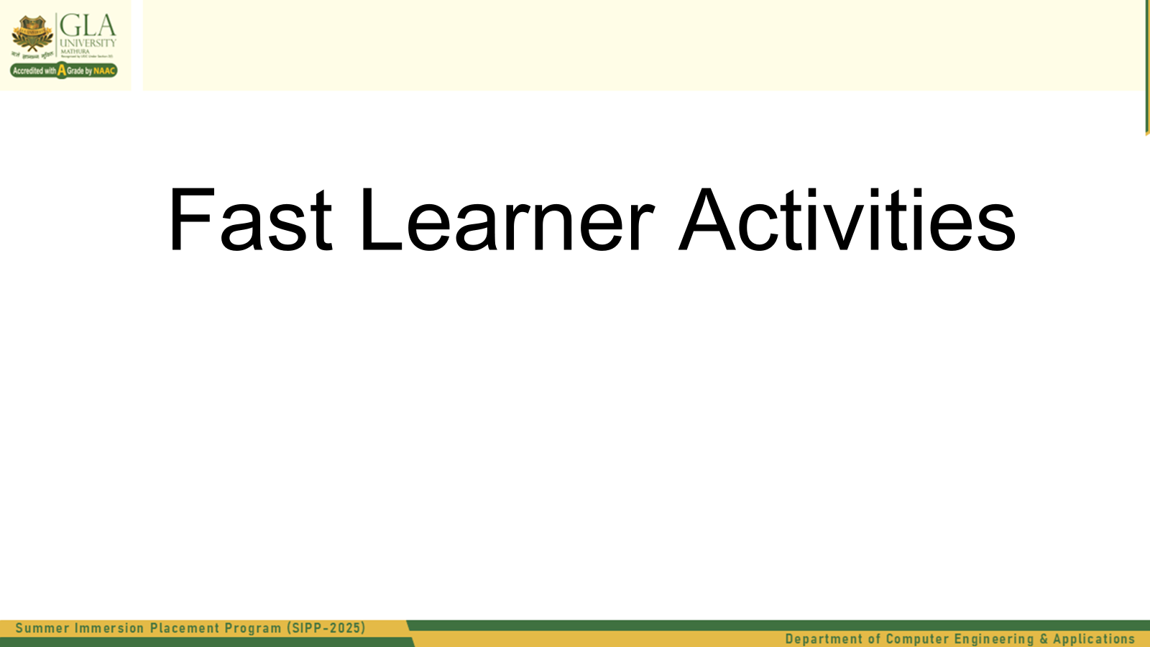

Slide 24
Performance Simulation Task
Scenario:
You are simulating a program with the following memory reference pattern:
1, 2, 3, 4, 1, 2, 5, 1, 2, 3, 4, 5
TLB can store 3 entries (LRU replacement)
RAM has 3 page frames
Page replacement follows FIFO policy
Question:
Calculate the number of page faults and TLB misses. Analyze how different TLB and page replacement strategies (e.g., LRU, Optimal) would change the outcome. Suggest the best configuration for minimizing both.

Slide 25
Memory Protection and Hardware Support in Memory Management
In the IBM/370, memory protection is provided through the use of keys. A key is a 4-bit quantity. Each 2K block of memory has a key (the storage key) associated with it. The CPU also has a key (the protection key) associated with it. A store operation is allowed only if both keys are equal, or if either is zero. Which of the following memory-management schemes could be used successfully with this hardware?
a. Bare machine
b. Single-user system
c. Multiprogramming with a fixed number of processes
d. Multiprogramming with a variable number of processes
e. Paging
f. Segmentation

Slide 26
Another Practice Question
3).Why are page sizes always powers of 2?
4). Consider a logical address space of 64 pages of 1024 words each, mapped onto a physical memory of 32 frames.
a. How many bits are there in the logical address?
b. How many bits are there in the physical address?

